Slide 1








CASELY: AI-Guided Socratic Dialogue for Developing
Social-Emotional Learning (SEL) Skills in Higher Education
Final Project – Research Project
Nahla Aboromy
Roba Hassan
Advisor: Dr. Naomi Unkelos Shpigel
Code: 26-1-R-5
1

Slide 2


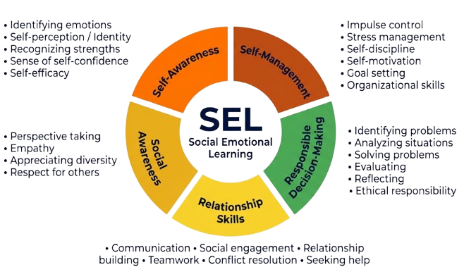




The CASEL Framework for SEL
Social-Emotional Learning (SEL) is the process of acquiring and applying skills that support emotional regulation, positive social interaction, intrinsic motivation, resilience, and responsible decision-making.
• Identifying emotions
• Self-perception / Identity
• Recognizing strengths
• Sense of self-confidence
• Self-efficacy
• Impulse control
• Stress management
• Self-discipline
• Self-motivation
• Goal setting
• Organizational skills
• Perspective taking
• Empathy
• Appreciating diversity
• Respect for others
• Identifying problems
• Analyzing situations
• Solving problems
• Evaluating
• Reflecting
• Ethical responsibility
• Communication • Social engagement • Relationship building • Teamwork • Conflict resolution • Seeking help
2
ASEL. (n.d.). The CASEL Framework for SEL. Retrieved January 19, 2026, from https://asel.co.il/
Notes:
Social-Emotional Learning, or SEL, is the process of learning and using skills that support emotion regulation coping, and social interaction.
According to SELIL The model shown here is the CASEL model, which organizes these skills into five core domains. this skill helps students cope with academic pressure, this ability directly supports learning outcomes and persistence, especially in demanding academic environments.”

Slide 3





The Problem: An Urgent Need for SEL in Higher Education
Escalating Challenges
Impact on Academic Success
Limitations of Existing Support
University students face increasing emotional and psychological challenges
These difficulties threaten well-being and create significant barriers to academic engagement and performance.
Many students lack practical, accessible, non-judgmental SEL practice opportunities.
3
Notes:
The problem our project is based on – the important need for Social-Emotional Learning in higher education. University students face increasing emotional and mental challenges, such as stress, depression, and loneliness. We also see this as students ourselves, These challenges do not remain at a personal level. They directly affect students’ well-being and create obstacles to learning, and academic success. although the need is clear many students do not have practical, easy to use and supportive way to practice SEL in higher education.
The next question is whether the existing tools in higher education truly address this need?

Slide 4






Current SEL Tools in Higher Education :The Gap
Non-Judgmental Spaces.
Always Available.
Instructor-Independent.
Automated Guidance.
Conclusion: There are no suitable tools that combine these features for higher education students.
4
Wang, D., & Ishak, Z. (2025). Unveiling the implementation of social-emotional learning among college students: A systematic literature review. International Journal of Learning, Teaching and Educational Research, 24(5), 376–399. https://doi.org/10.26803/ijlter.24.5.20
Notes:
As highlighted in the systematic review conducted by Wang and Ishak (2025), current SEL implementations in higher education lack tools that are continuously available, automated, non-judgmental, and independent of instructors. In conclusion, there are no suitable tools that combine all these features for higher education students. ✅

Slide 5

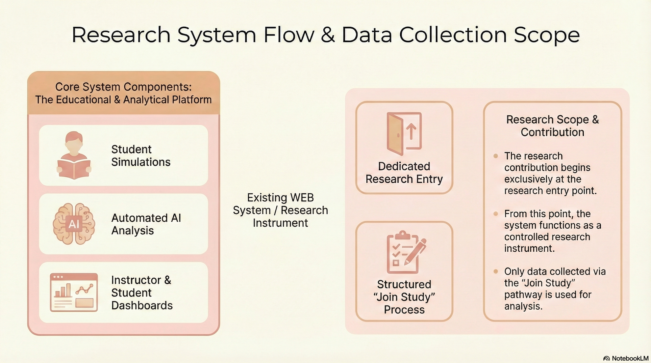




Where We Started
Initial Context: An Educational Platform
Adaptation for Research: A Controlled Instrument
Core Components: Educational & Analytical
Research Mode
Dedicated research entry
Structured “join Study ” flow
Only study-path data analyzed
Student Experience
Research Entry
Existing WEB system
Automated AI Analysis
Instructor & Student Dashboards
“Join Study” Process
5
The final project builds on an existing system by introducing a dedicated research pathway.
Notes:
Initial Context: An Educational Platform
The project foundation was a CASEL-based AI system developed in a prior WEB course for general
Adaptation for Research: A Controlled Instrument The existing system was repurposed by creating a dedicated entry point to serve as a structured tool for this study
educational use
The project began as an AI-based educational system developed in a previous web course .For this study, the system was adapted into a controlled research tool by adding a dedicated research entry point and a structured ‘Join Study’ process. From that point on, the system was used only for research and only data collected through this pathway was analyzed.”

Slide 6




Functional Requirements
Anonymous Participation: Collect any personally identifying information (random UUID)
Pre/Post Questionnaires: Saves responses for the validated CASEL questionnaire at the start (Pre) and end (Post).
Socratic Dialogue (Experimental Groups): Interactive chat for a guided, non-judgmental Socratic dialogue based on user input.
Automatic CASEL-Based Analysis: Generates a structured assessment across the five CASEL competencies.
6

Slide 7




Non-Functional Requirements
Performance:
AI analysis < 15s; AI Socratic response < 5s; Page loads < 2s.
Availability:
System must be available at least 99% of the time.
Privacy and Security:
All data stored anonymously using UUIDs.
Ethical Considerations: Transparent communication on anonymity and data usage. AI tone must be non-judgmental, warm, and supportive.
7

Slide 8



What Is a Socratic Bot?
Definition
The Socratic Bot in Our Study
Expected Contribution
Inquiry through open-ended questions
Promotes reflection and self-awareness
AI-based conversational agent
Supports self-reflection
No advice, instruction, or evaluation
Supports SEL competencies through reflective engagement
8
Wang, D., & Ishak, Z. (2025). Unveiling the implementation of social-emotional learning among college students: A systematic literature review. International Journal of Learning, Teaching and Educational Research, 24(5), 376–399. https://doi.org/10.26803/ijlter.24.5.20
Notes:
“Recent studies highlight a lack of frameworks for examining SEL development in digital and AI-mediated environments.”

Slide 9

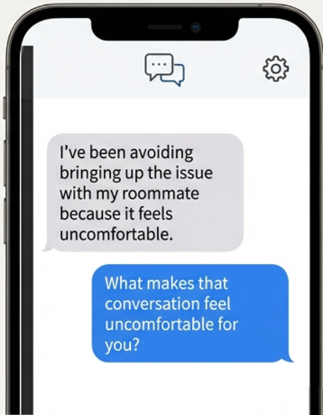
The Proposed Solution: CASELy
An anonymous web platform that leverages AI to foster SEL skills through reflective, Socratic dialogue.
Core Principles:
AI-Guided Socratic Dialogue
No Advice, No Judgment
Reflection-Based Learning
9

Slide 10
RESEARCH QUESTION
How does an AI-based Socratic dialogue influence the development of SEL skills among higher education students?
10

Slide 11
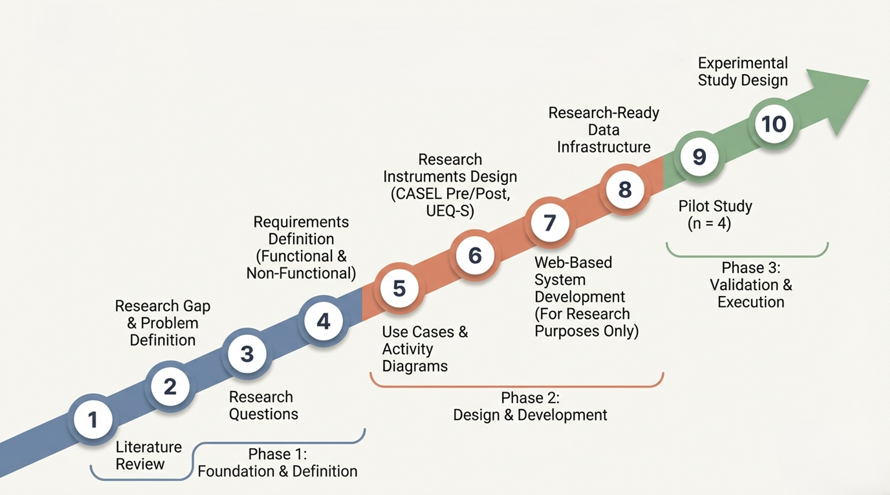


Research Engineering process
Pilot Study:
11

Slide 12
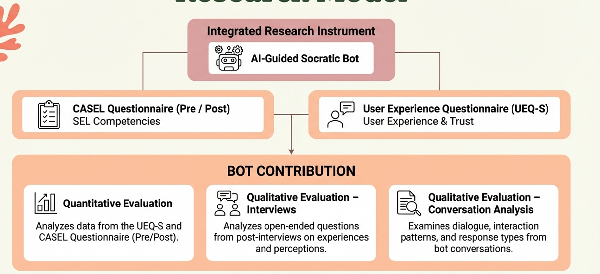

Research Model
Ahmad Feisal, A. A., & Singh, S. K. S. (2025). Social and emotional learning (SEL) awareness of undergraduates in Malaysia: A case of a public university in Malaysia. International Journal of Modern Education, 7(25), 633–646. https://doi.org/10.35631/IJMOE.725043
Schrepp, M., Hinderks, A., & Thomaschewski, J. (2017). Design and evaluation of a short version of the User Experience Questionnaire (UEQ-S). International Journal of Interactive Multimedia and Artificial Intelligence, 4(6), 103–108. https://doi.org/10.9781/ijimai.2017.09.001
12

Slide 13
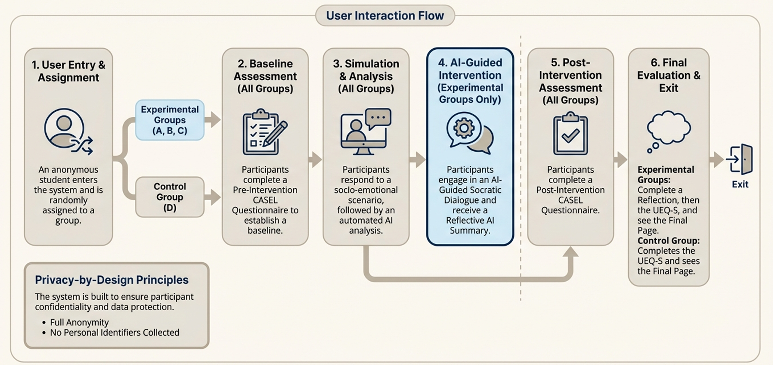




Research User Journey
13

Slide 14




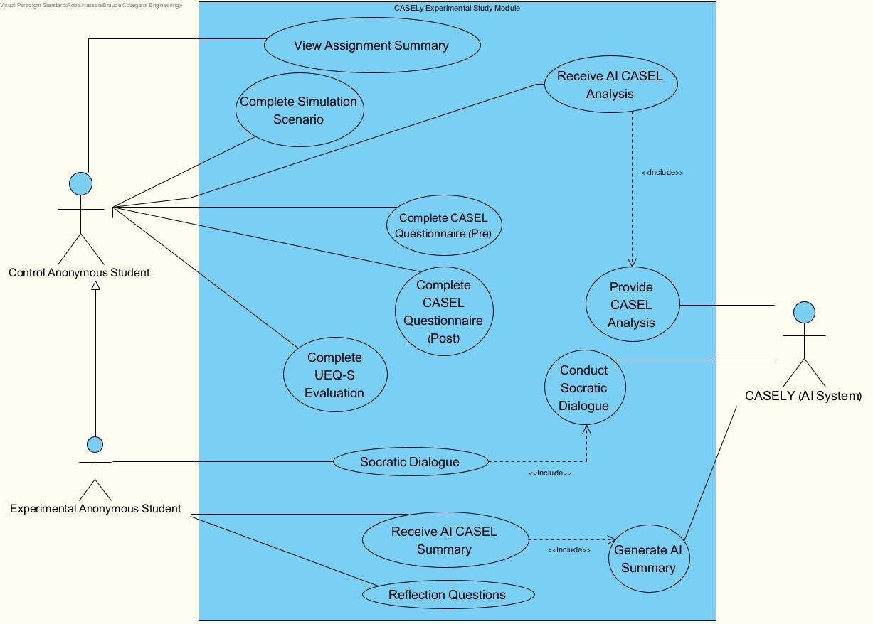
Use Case Diagram
14
Notes:
The use case diagram focuses on the scenarios relevant to the study and does not represent the system functional.
The diagram includes two groups of students: an experience group and a control group. Both groups complete the simulation scenario and fill in the CASEL questionnaires pre and post, as well as the UEQ-S questionnaire, and both receive AI-based CASEL analysis of their simulation performance, only the experimental group participates in a Socratic dialogue conducted with the CASLY system, completes reflection questions, and receives an AI-generated summary .CASELY, the external AI system, is responsible for conducting the Socratic dialogue and provide CASEL analysis and to generate feedback and summaries.

Slide 15

Pilot study(N=4)
Pilot study with four 4th-year software engineering students (3 experimental, 1 control; ages 20–25)
Key Takeaways:
Strong Positive engagement with the AI-guided Socratic dialogue.
Clear and intuitive user experience.
initial indications of improved SEL understanding
" It felt like I was talking to someone ,not just a bot.”
“It didn’t just give random answers- it responded directly to what I had said .”
“The anonymity allowed me to feel free to talk about things I would not normally say out loud.”
15
Notes:
“We ran a small pilot with four fourth-year software engineering students to test if the system was easy to use and if the AI-guided Socratic dialogue felt meaningful.
As reflected in participants’ quotes, they described the interaction as human-like — not just a robot giving pre-set answers, but a conversation that responded directly to what they shared. They also said that the anonymity allowed them to speak more openly about their thoughts and emotions,
indicating that the dialogue could support and improve SEL by encouraging open reflection in a safe and meaningful way.”
“This means the dialogue helps students improve SEL by giving them a safe space to openly think and talk about their experiences.”

Slide 16
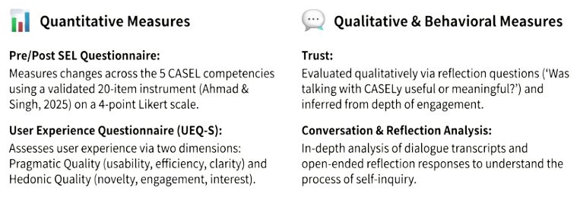

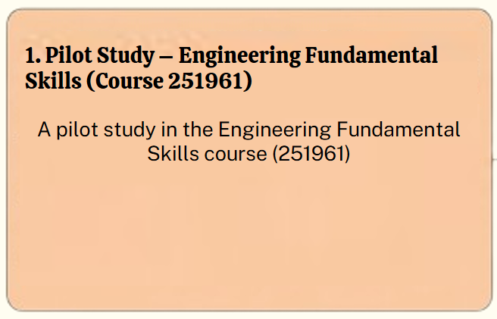
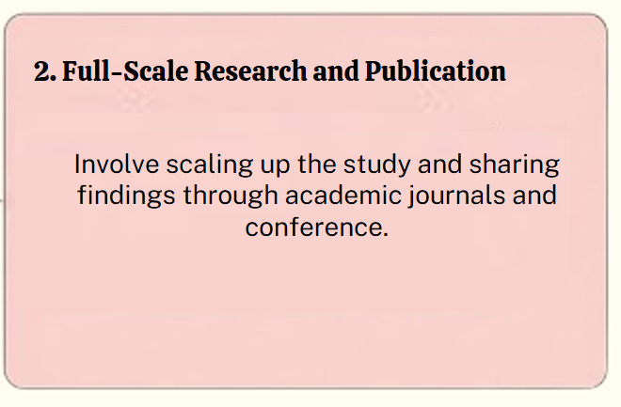













Research Measures A Mixed-Methods Approach
Quantitative Measures
Qualitative Measures
Quantitative Measures
Qualitative & Behavioral Measures
Pre/Post SEL Questionnaire:
Trust:
Pre/Post SEL Questionnaire:
Measures changes across the 5 CASEL competencies.
User Experience Questionnaire (UEQ-S):
User experience is measured through pragmatic and hedonic qualities.
Trust:
reflection questions :
Was talking with CASELY useful or meaningful?
Conversation & Reflection Analysis:
In-depth analysis of dialogue transcripts and open-ended reflection responses
Measures changes across the 5 CASEL competencies
reflection questions :
Was talking with CASELY useful or meaningful?
User Experience Questionnaire (UEQ-S):
Conversation & Reflection Analysis:
User experience is measured through pragmatic and hedonic qualities
In-depth analysis of dialogue transcripts and open-ended reflection responses
We aim for ≥80% on the SEL questionnaire and ≥1.8 out of 3 on each UEQ-S dimension, indicating strong social-emotional skills and a positive user experience.
16
Notes:
The success measures are based on a mixed-methods approach.
Quantitative measures :, we used two validated questionnaires. One of them is a pre- and post-SEL questionnaire with 20 items measuring the five CASEL competencies, rated on a 4-point Likert scale from 1 to 4, without a middle option, to better capture meaningful change.
And The UEQ-S questionnaires includes eight items rated on a 7-point scale .and evaluates user experience in two dimensions: pragmatic quality, which includes usability and clarity of the system, and hedonic quality, which includes users’ interest and enjoyment.
Scores are centered around zero, with positive values indicating a positive user experience.
Qualitative measures
Trust measures :
we used open-ended questions, such as “Was talking with CASELY useful or meaningful?”.
We used it because participants need to feel safe to reflect honestly, especially when interacting with AI about sensitive emotions.
לכן השאלה:
“Was talking with CASELY useful or meaningful?”
בודקת בעקיפין:
האם הסטודנט הרגיש שמקשיבים לו ,האם האינטראקציה הרגישה בטוחה ולא שיפוטית
האם נוצר בסיס רגשי שמאפשר המשך שימוש.
And the last one is Conversation and reflection analysis is conducted by analyzing dialogue and open reflective response to understand better the processes of self-reflection
to understand how participants reflect on themselves and their emotions. This helps us see if the system truly supports meaningful self-reflection. Its important to know how participants examine their emotions, and experiences to gain greater self-awareness
Self-reflection” או רפלקציה עצמית משמעותה לחשוב ולהרהר על עצמך, על המחשבות, הרגשות, ההתנהגויות והתגובות שלך בסיטואציות שונות.

Slide 17
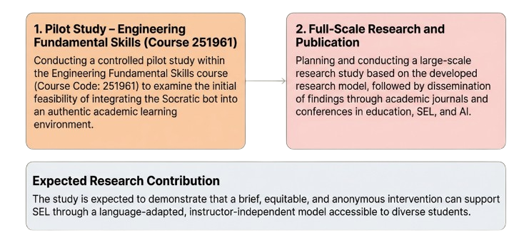

Future Research Plan
1. Pilot Study – Engineering Fundamental Skills (Course 251961)
2. Full-Scale Research and Publication
A pilot study in the Engineering Fundamental Skills course (251961)
Involve scaling up the study and disseminating findings through academic journals and conference in education SEL and AI.
Expected Research Contribution
The study is expected to demonstrate that a brief, equitable, and anonymous intervention can support SEL through a language-adapted, instructor-independent model accessible to diverse students.
17

Slide 18
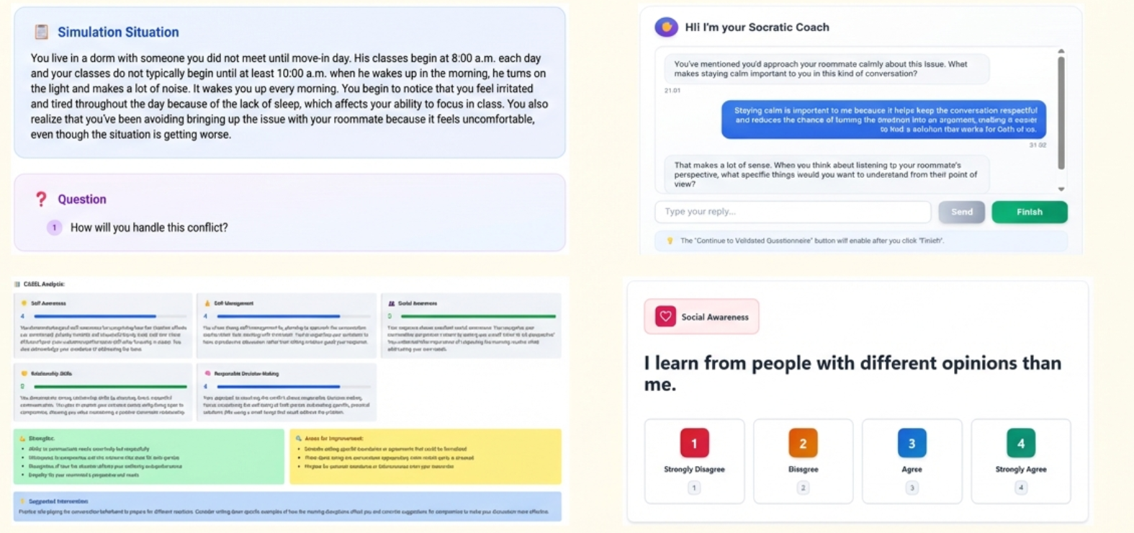
System Screenshots – Research Instrument Overview
The following screenshots illustrate key stages of the experimental flow, providing visual context for the web-based research instrument.
Demo:
https://youtu.be/bzZzAnVFnUs?si=_JEeGuydIcTbMHNk
18

Slide 19
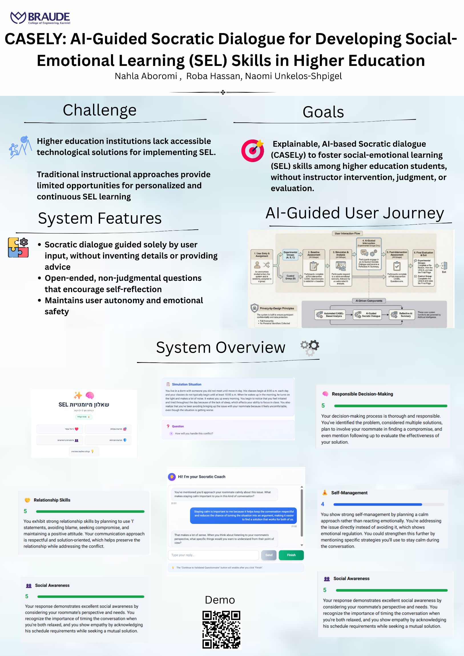
invited poster presentation –
CHAIS 2026
The 21st Conference on the Study of Innovation and Learning Technologies
The Open University of Israel
19
February 24, 2026 · Accepted Poster Presentation

Slide 20





Thank you.
Questions?
20

